Slide 1
Multimodal Abnormality Detection - 2

Slide 2
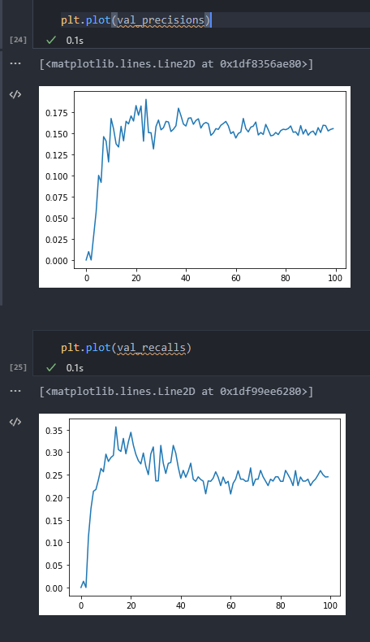
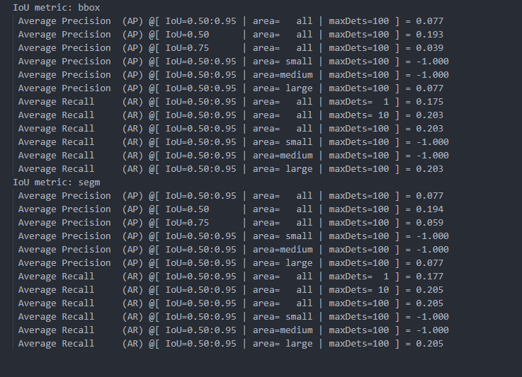
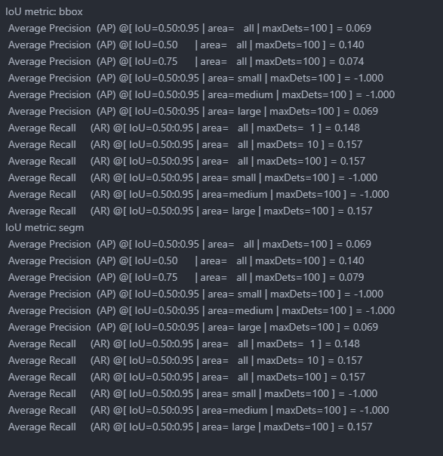
Overfitting
In previous experiments, we found that the model trained with 100 epochs has a worse performance compared to the model with only 10 epochs training. After plotting the validation precision and recall, we found the model suffer from overfitting.
Precision
Recall
10 epochs
10 epochs
Epoch

Slide 3
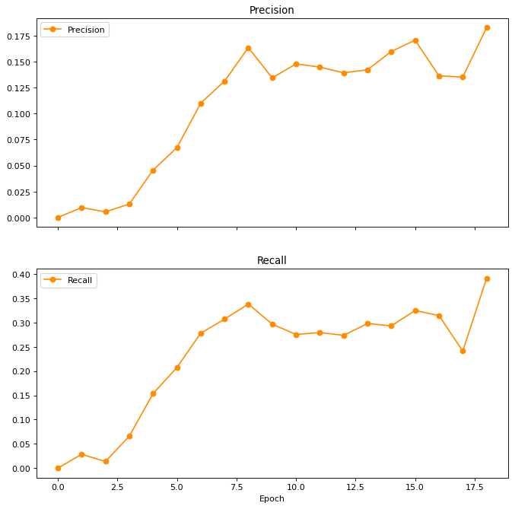
Early stopping
To solve the overfitting issue, we adopted early stopping. This method is to save the model when it reach the peak performance before dropping. By doing this, we’re able to train the each model and get their optimal performance.
Peak

Slide 4
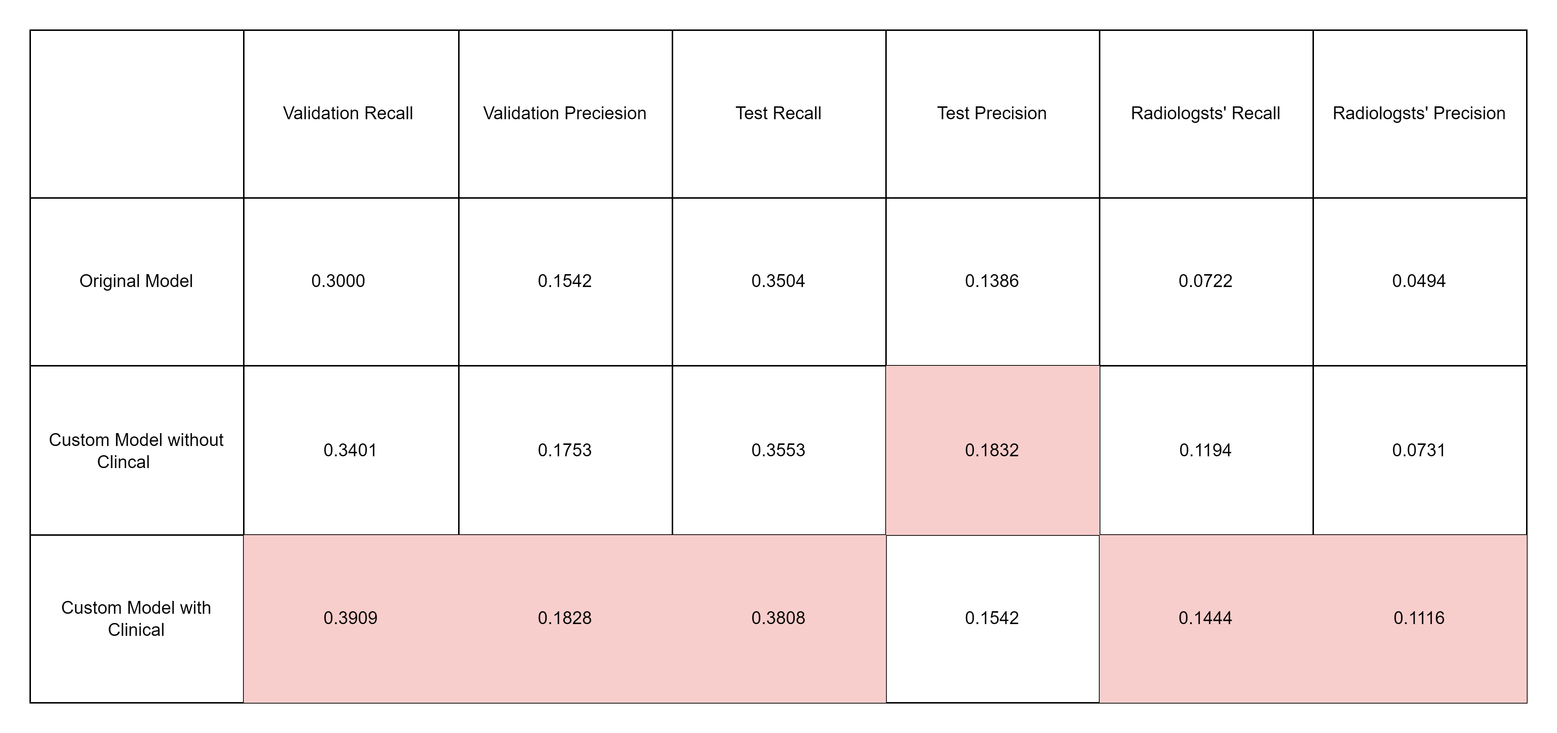
Performance IoU Table
In this table, we can see our model with clinical perform best.
(Note: In the medical domain, a higher recall is preferable than precision.)

Slide 5
Low Recall and Precision.
Inconsistency in dataset.

Slide 6
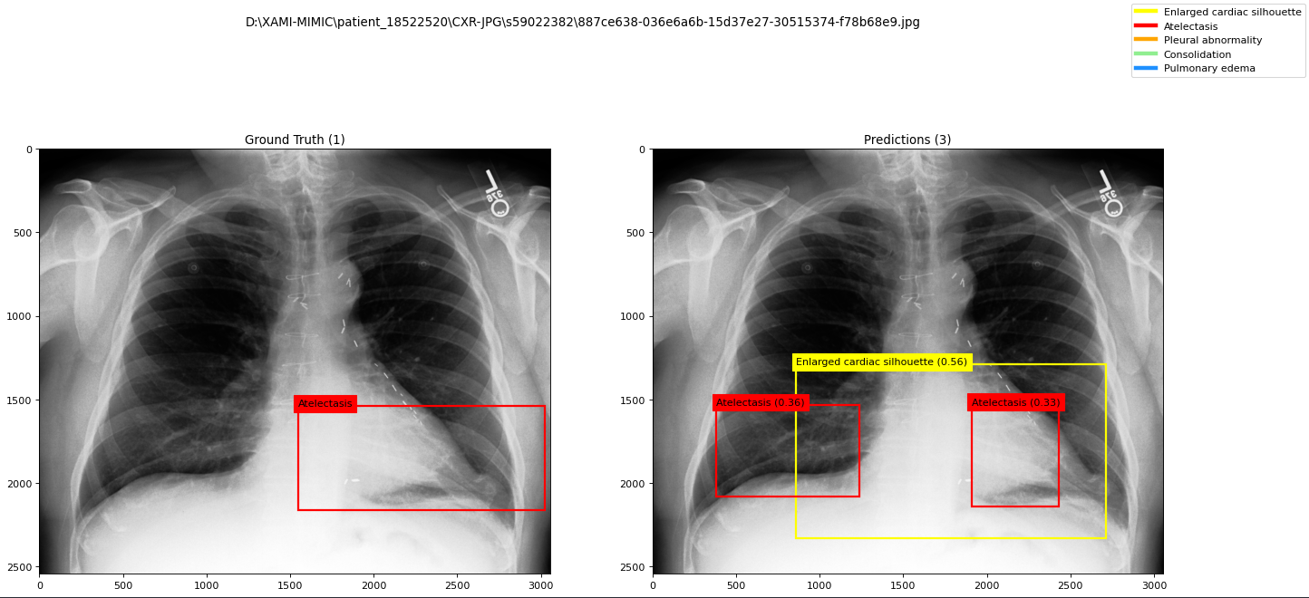
Not performing well, if you just look at one instance.

Slide 7
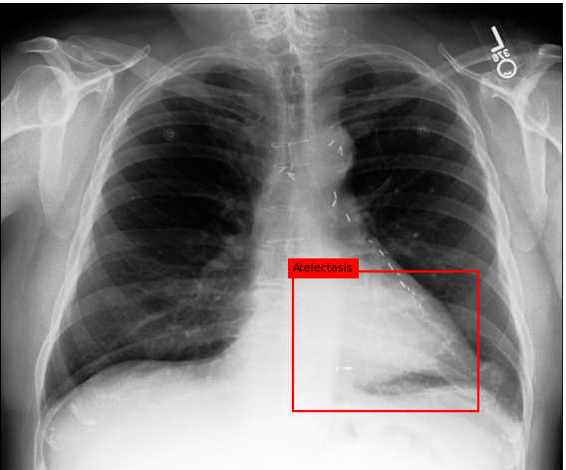
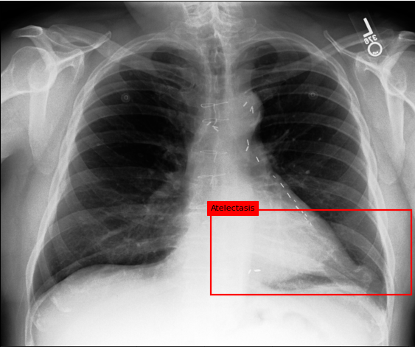
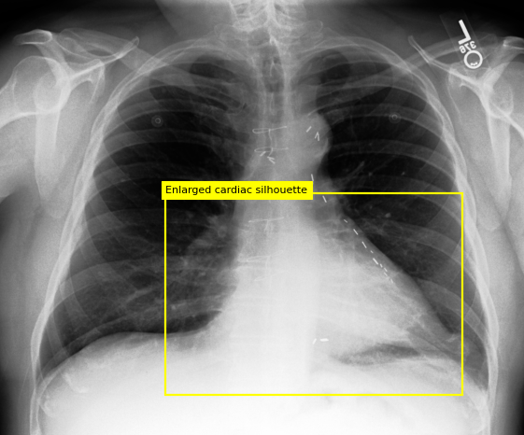
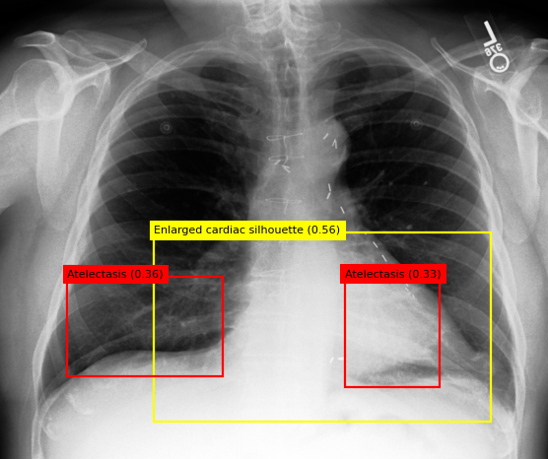
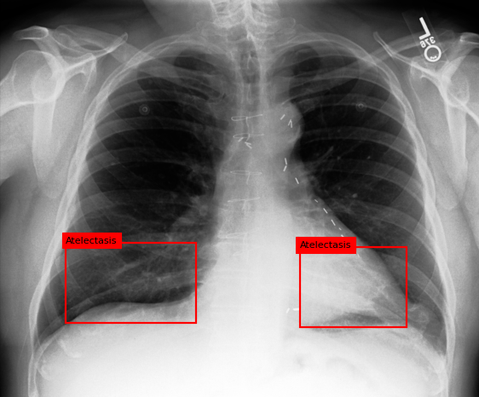
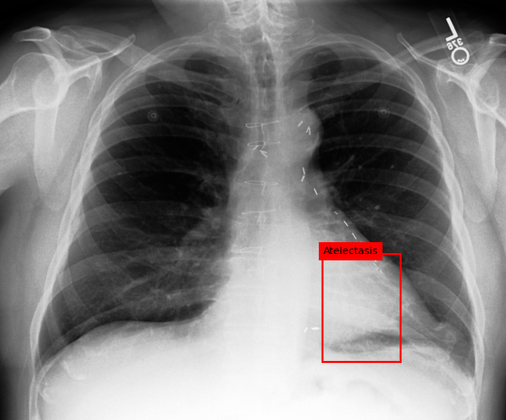
However, This same image is annotated by 5 different radiologists, and the annotations can be very different. And, the model actually pick up all of them. This inconsistency is also the reason why the precision and recall are not high.
Prediction
Ground Truth

Slide 8
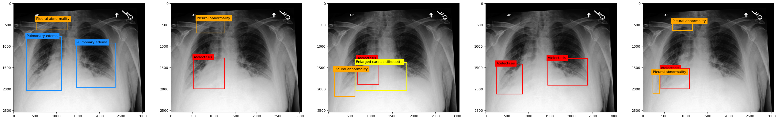
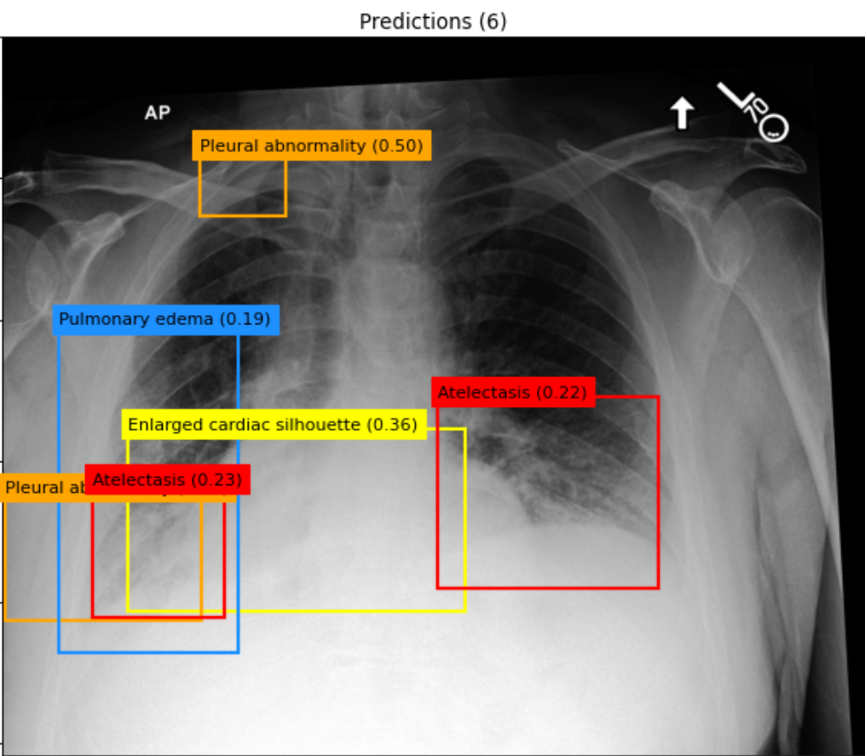
Another Example
Ground Truth
Prediction

Slide 9
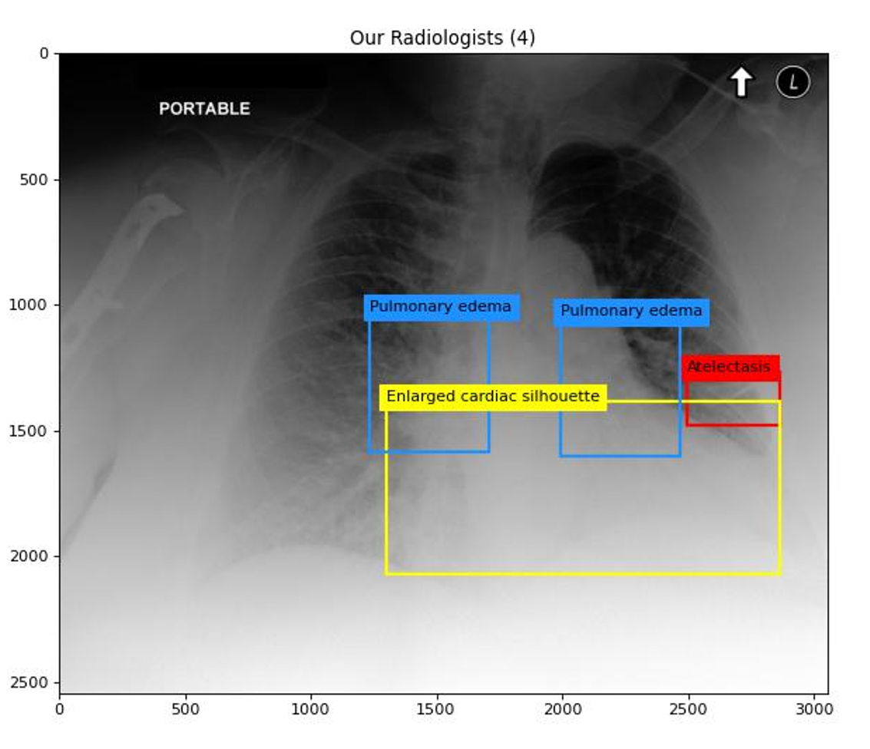
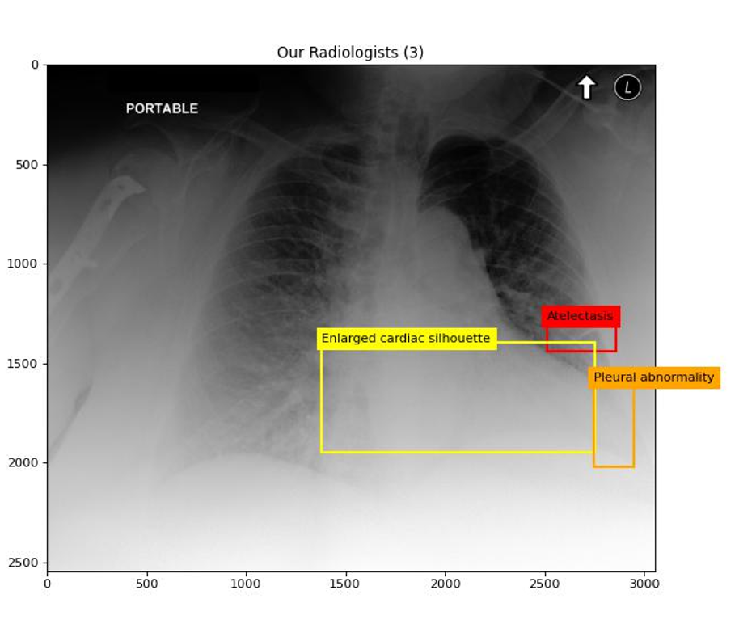
Even in our own dataset.

